Slide 1
Team 10 Restaurant Database Management App
Sorin Olteanu, Ben Griffiths, Diego Tolerado, Gunjan Sahityani,
Junaid Alam, Lorenzo Menegotto, Uyi Fitzpatrick

Slide 2
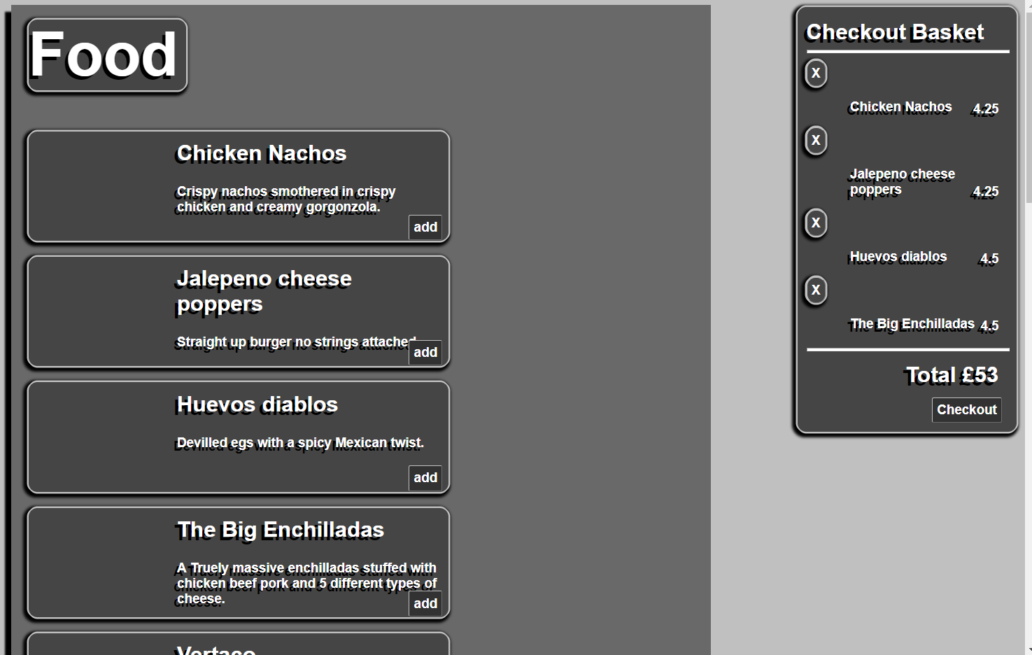
Home Page - Menu
[…]

Slide 3
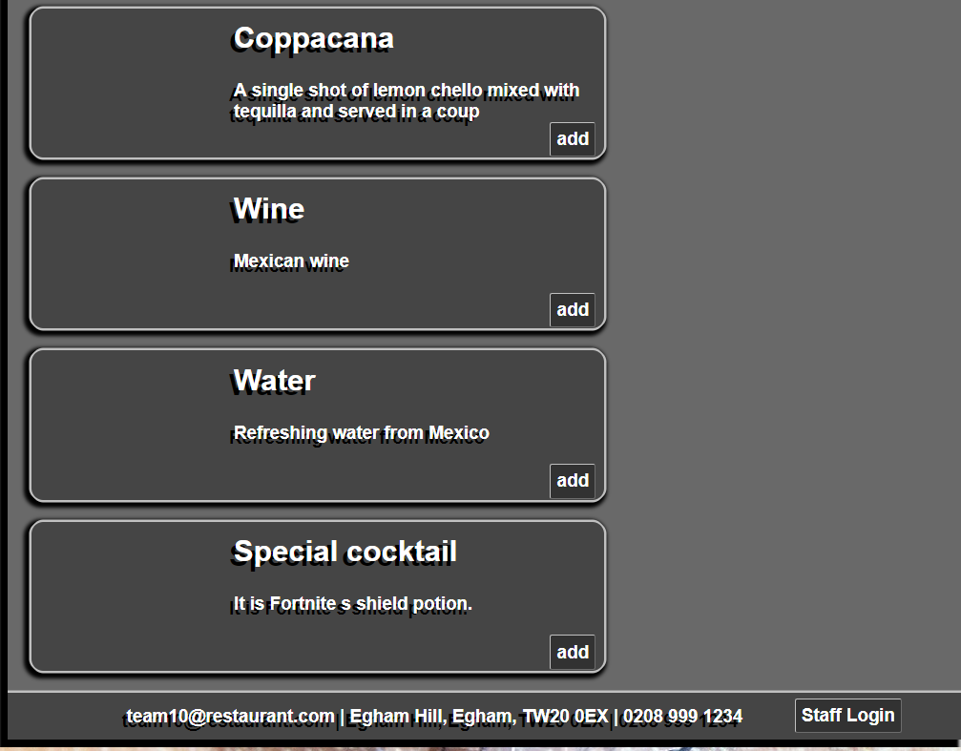
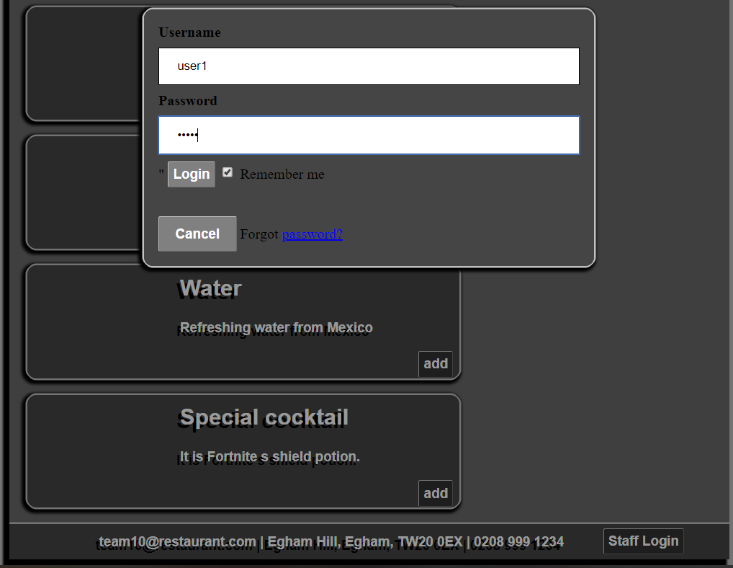
Staff – Log In
[…]

Slide 4
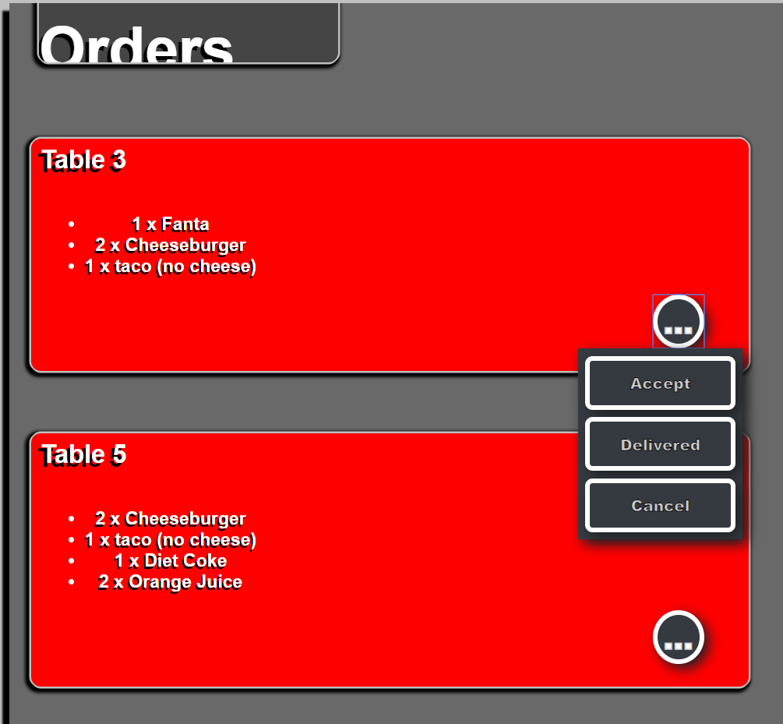
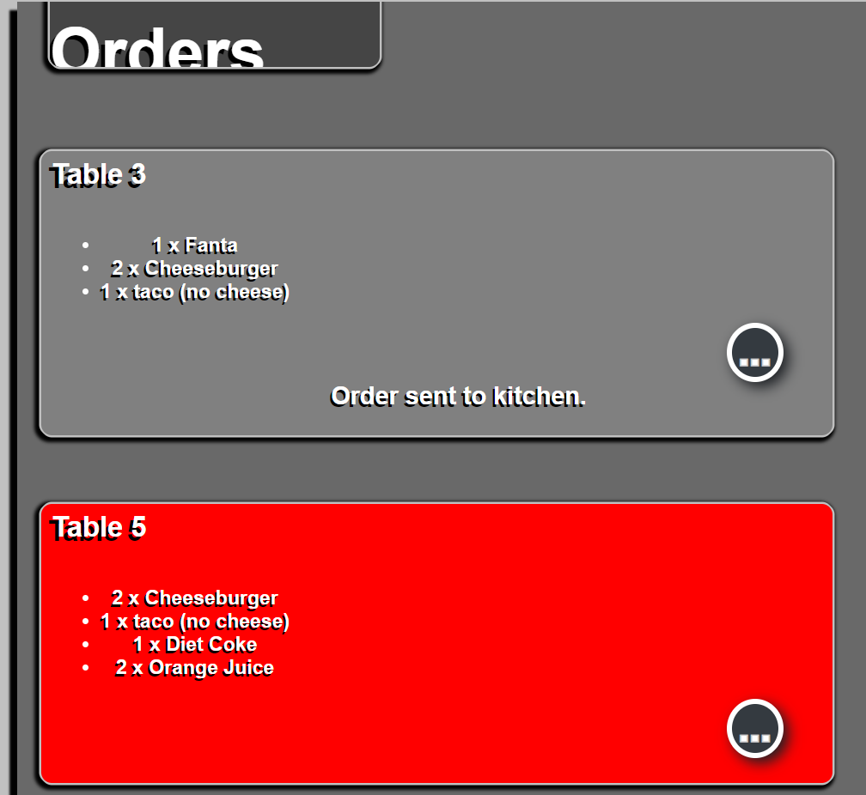
Waiter Screen – Accept Order

Slide 5
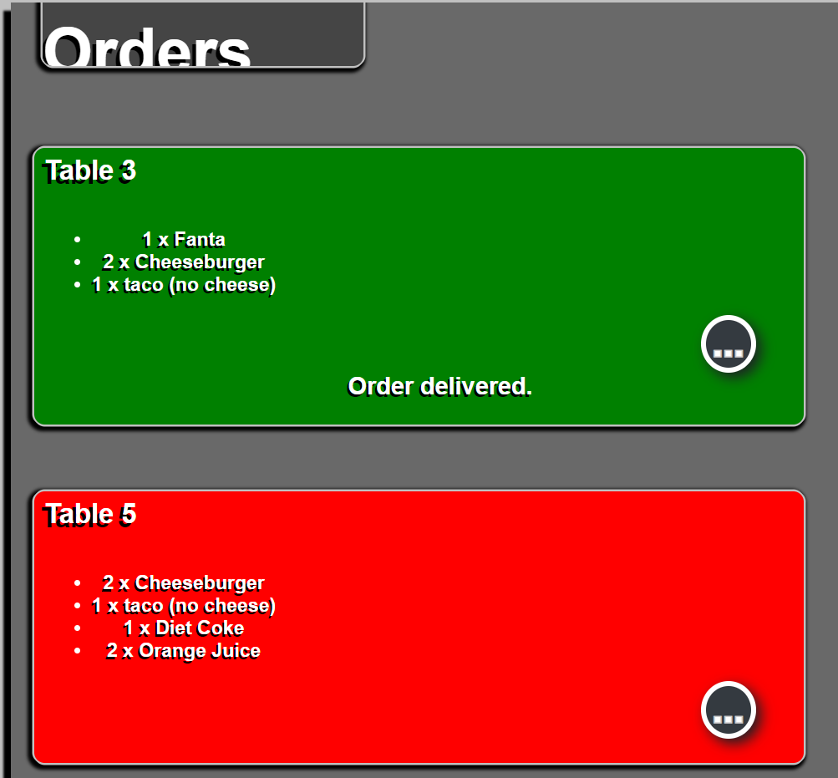
Waiter Screen – Set Ordered - Delivered

Slide 6
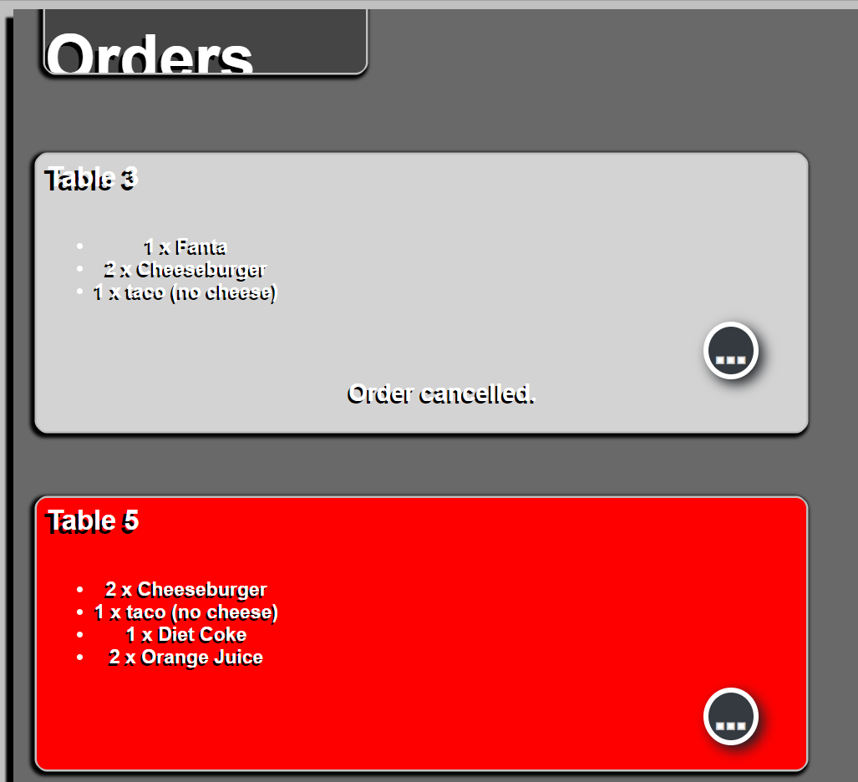
Waiter Screen – Cancel Order

Slide 7
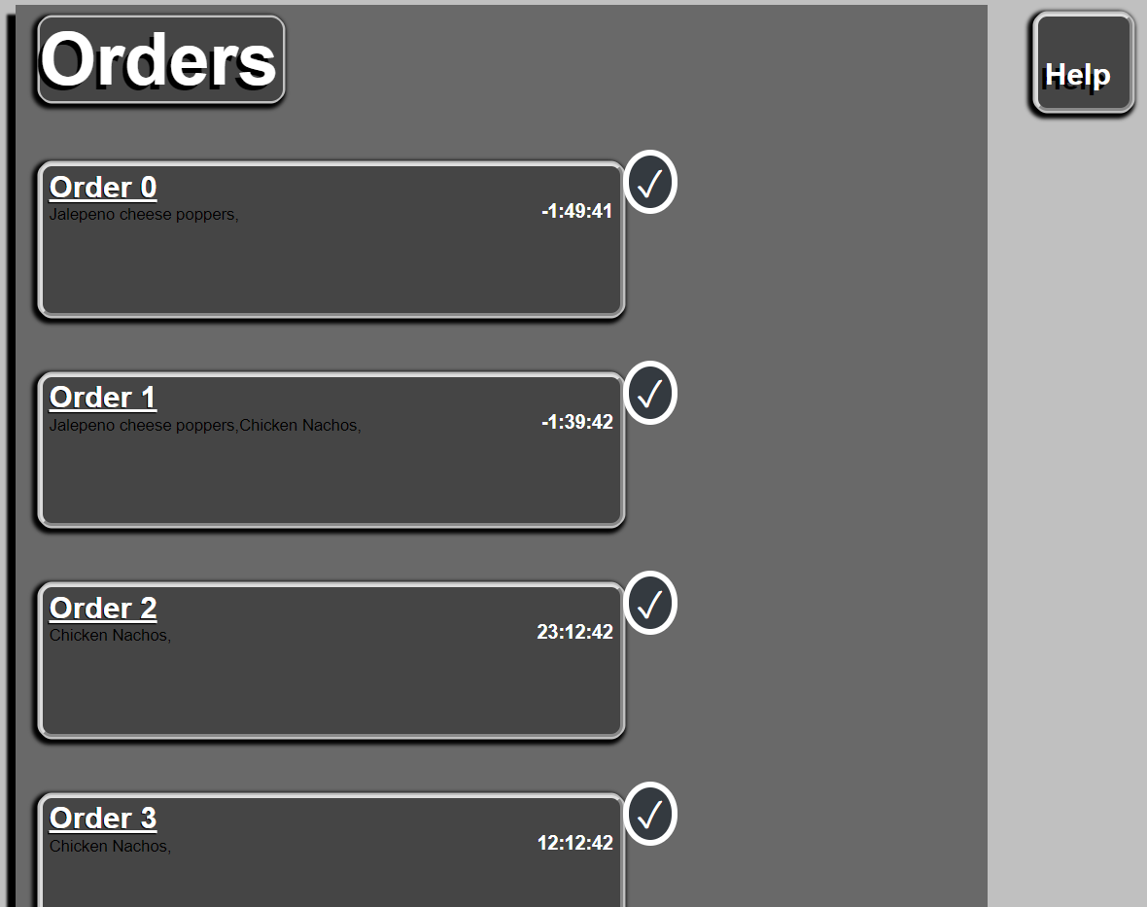
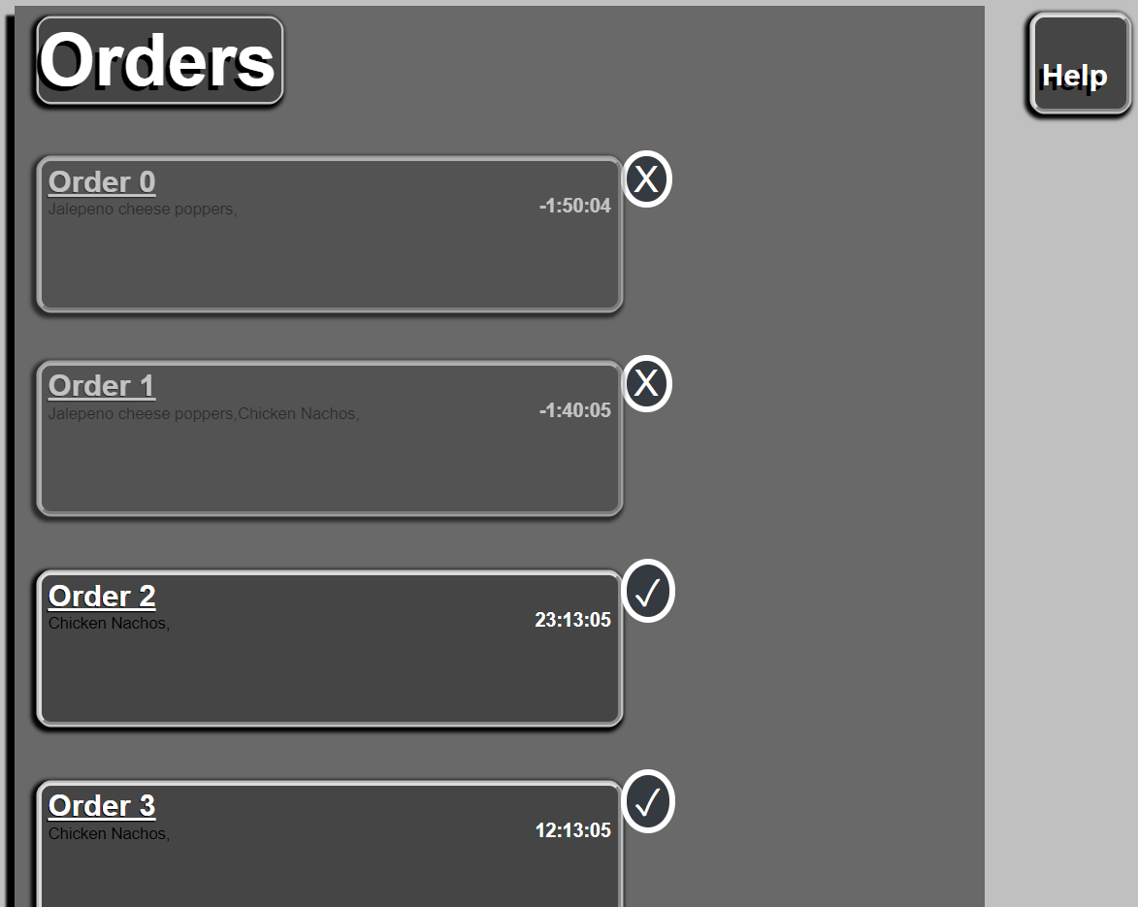
Kitchen Screen

